Slide 1


Application Layer
Computer Networking: A Top Down Approach 6th edition Jim Kurose, Keith Ross Addison-Wesley March 2012
All material copyright 1996-2012
J.F Kurose and K.W. Ross, All Rights Reserved

Slide 2
Application Layer
Principles of Network Applications
Web and HTTP
FTP
Electronic mail
SMTP, POP3, IMAP
DNS
Socket programming with UDP and TCP

Slide 3
Some Network Apps
e-mail
Web
Text messaging
Remote login
P2P file sharing
Multi-user network games
Streaming stored video (YouTube, Hulu, Netflix)
Voice over IP (e.g., Skype)
Real-time video conferencing
Social networking
Search
…
…

Slide 4

















Creating a Network App
Write programs that:
Run on (different) end systems
Communicate over network
e.g. web server software communicates with browser software
No need to write software for network-core devices
Network-core devices do not run user applications
Applications on end systems allow rapid app development, propagation
application
transport
network
data link
physical
application
transport
network
data link
physical
application
transport
network
data link
physical

Slide 5
Application Architectures
Possible structure of applications:
Client-Server
Peer-to-Peer (P2P)
Hybrid of Client-Server and P2P

Slide 6
Client-Server Architecture
Server:
Always-on host
Permanent IP address
Data centers for scaling
Clients:
Communicate with server
May be intermittently connected
May have dynamic IP addresses
Do not communicate directly with each other
client/server

Slide 7
P2P Architecture
Peer
No always-on server
Arbitrary end systems directly communicate
Highly scalable but difficult to manage
Peers request service from other peers, provide service in return to other peers
Self scalability – new peers bring new service capacity, as well as new service demands
Peers are intermittently connected and change IP addresses
Complex management
peer-peer

Slide 8
Client-Server vs. Peer-to-Peer

Slide 9
Hybrid of Client-Server and P2P
Skype
Voice-over-IP P2P application
Centralized Server: finding address of remote party
Client-Client Connection: Direct (not through server)
Instant messaging
Chatting between two users is P2P
Centralized service: client presence
Detection/location
User registers its IP address with central server when it comes online
User contacts central server to find IP addresses of buddies

Slide 10
Processes Communicating
Process: Program running within a host
Within same host, two processes communicate using inter-process communication (defined by OS)
Processes in different hosts communicate by exchanging messages
Clients, servers
client process: process that initiates communication
server process: process that waits to be contacted
Aside: Applications with P2P architectures have client processes & server processes

Slide 11

Sockets
A process sends messages into, and receives messages from, the network through a software interface called a Socket.
A process is analogous to a house and its socket is analogous to its door.
Sending process shoves message out door
Sending process relies on transport infrastructure on other side of door to deliver message to socket at receiving process
application
socket
application
controlled by
app developer
process
process
transport
transport
network
network
controlled
by OS
link
Internet
link
physical
physical

Slide 12
Addressing Processes
To receive messages, process must have identifier
Host device has unique 32-bit IP address
Q: Does IP address of host on which process runs suffice for identifying the process?
A: No, many processes can be running on same host
Identifier includes both IP address and port numbers associated with process on host.
Example port numbers:
HTTP server: 80
mail server: 25

Slide 13
App-layer Protocol Defines
Types of messages exchanged,
e.g., request, response
Message syntax:
what fields in messages & how fields are delineated
Message semantics
meaning of information in fields
Rules for when and how processes send & respond to messages
Open Protocols:
Defined in RFCs
Allows for interoperability
e.g. HTTP, SMTP, FTP
Proprietary Protocols:
e.g. Skype

Slide 14
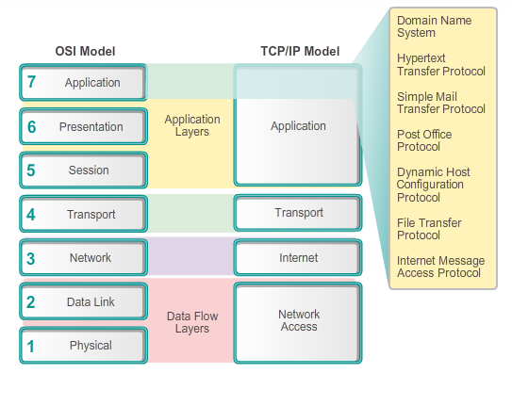
Application Layer Protocols

Slide 15
Application Layer Protocols
Domain Name Service Protocol (DNS) – used to resolve Internet names to IP addresses
Telnet – a terminal emulation protocol used to provide remote access to servers and networking devices
Bootstrap Protocol (BOOTP) – a precursor to the DHCP protocol, a network protocol used to obtain IP address information during bootup
Dynamic Host Control Protocol (DHCP) – used to assign an IP address, subnet mask, default gateway and DNS server to a host
Hypertext Transfer Protocol (HTTP) – used to transfer files that make up the Web pages of the World Wide Web

Slide 16
Application Layer Protocols
File Transfer Protocol (FTP) - used for interactive file transfer between systems
Trivial File Transfer Protocol (TFTP) - used for connectionless active file transfer
Simple Mail Transfer Protocol (SMTP) - used for the transfer of mail messages and attachments
Post Office Protocol (POP) - used by email clients to retrieve email from a remote server
Internet Message Access Protocol (IMAP) – another protocol for email retrieval

Slide 17
What transport service does an app need?
Reliable Data Transfer
Some apps (e.g. file transfer, web transactions) require 100% reliable data transfer
Other apps (e.g. audio) can tolerate some loss
Throughput
Some apps, bandwidth sensitive applications, (e.g., multimedia) require minimum amount of throughput to be “effective”
Other apps -“elastic apps”- make use of whatever throughput they get (e.g., email, file transfer)
Timing
Some apps (e.g. Internet telephony, interactive games) require low delay to be “effective”
Security
Encryption, confidentiality, data integrity, …

Slide 18
Transport service requirements: common apps
Application
file transfer
e-mail
Web documents
Internet telephony
/video conferencing
stored audio/video
interactive games
instant messaging
Data loss
no loss
no loss
no loss
loss-tolerant
loss-tolerant
loss-tolerant
no loss
Throughput
elastic
elastic
elastic
audio: 5kbps-1Mbps
video:10kbps-5Mbps
same as above
few kbps up
elastic
Time sensitive
no
no
no
yes
yes, few secs
yes
yes and no

Slide 19
Internet transport protocols services
TCP service:
Connection-oriented: setup required between client and server processes
Reliable transport between sending and receiving process
Flow control: sender won’t overwhelm receiver
Congestion control: throttle sender when network overloaded
Does not provide: timing, minimum throughput guarantee, security
UDP service:
Unreliable data transfer between sending and receiving process
Does not provide: reliability, flow control, congestion control, timing, throughput guarantee, security, or connection setup,
Q: why bother? Why is there a UDP?

Slide 20
Internet apps: Application, Transport protocols
Application
Layer Protocol
SMTP [RFC 2821]
Telnet [RFC 854]
HTTP [RFC 2616]
FTP [RFC 959]
HTTP (e.g. YouTube), RTP [RFC 1889]
SIP, RTP, proprietary
(e.g. Skype)
Underlying
Transport Protocol
TCP
TCP
TCP
TCP
TCP or UDP
TCP or UDP
Application
e-mail
remote terminal access
Web
file transfer
streaming multimedia
Internet telephony
HTTP: Hypertext Transfer Protocol
RTP: Real-time Transport Protocol
SIP: Session Initiation Protocol
SMTP: Simple Mail Transfer Protocol
FTP: File Transfer Protocol

Slide 21
Securing TCP
TCP & UDP
no encryption
cleartext passwords sent into socket traverse Internet in cleartext
SSL Secure Sockets Layer
provides encrypted TCP connection
data integrity
end-point authentication
SSL is at app layer
apps use SSL libraries, that “talk” to TCP
SSL socket API
cleartext passwords sent into socket traverse Internet encrypted

Slide 22
Web and HTTP
A review…
Web page consists of objects
Object can be HTML file, JPEG image, Java applet, audio file,…
Web page consists of base HTML-file which includes several referenced objects
Each object is addressable by a single URL, e.g.,
www.someschool.edu/someDept/pic.gif
host name
path name

Slide 23
HTTP overview
HTTP: HyperText Transfer Protocol
Web’s application layer protocol
Client/Server model
Client: Web browsers (such as Internet Explorer and Firefox) implement the client side of HTTP
Browser requests, receives, (using HTTP protocol) and “displays” Web objects
Server: Web servers, which implement the server side of HTTP, house Web objects, each addressable by a URL.
Web server sends (using HTTP protocol) objects in response to requests
Popular Web servers include Apache and Microsoft Internet Information Server

Slide 24

HTTP overview (continued)
HTTP request
PC running
Firefox browser
HTTP response
HTTP request
server
running
Apache Web
server
HTTP response
iphone running
Safari browser
HTTP request-response behavior

Slide 25
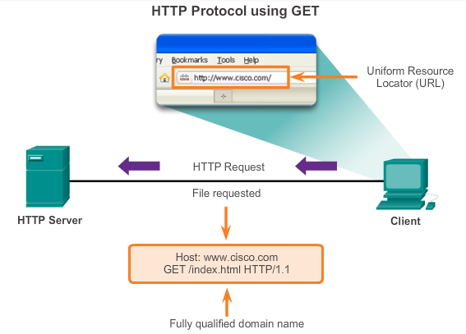
HTTP overview (continued)

Slide 26
HTTP overview (continued)
HTTP Uses TCP as underlying Transport Protocol:
The HTTP client first initiates a TCP connection with the server.
Server accepts TCP connection from client.
Once the connection is established, the browser and the server processes access TCP through their socket interfaces.
On the client side the socket interface is the door between the client process and the TCP connection.
On the server side it is the door between the server process and the TCP connection.
HTTP messages (application-layer protocol messages) exchanged between browser (HTTP client) and Web server (HTTP server)

Slide 27
HTTP overview (continued)
HTTP is “stateless”
An HTTP server maintains no information about past client requests
aside
Protocols that maintain “state” are complex!
Past history (state) must be maintained
If server/client crashes, their views of “state” may be inconsistent, must be reconciled

Slide 28
HTTP connections
Non-persistent HTTP
At most one object sent over TCP connection
connection then closed
Downloading multiple objects required multiple connections
Persistent HTTP
Multiple objects can be sent over single TCP connection between client and server

Slide 29
Non-persistent HTTP
suppose user enters URL:
(contains text,
references to 10
jpeg images)
www.someSchool.edu/someDepartment/home.index
1a. HTTP client initiates TCP connection to HTTP server (process) at www.someSchool.edu on port 80
1b. HTTP server at host www.someSchool.edu waiting for TCP connection at port 80. “accepts” connection, notifying client
2. HTTP client sends HTTP request message (containing URL) into TCP connection socket. Message indicates that client wants object someDepartment/home.index
3. HTTP server receives request message, forms response message containing requested object, and sends message into its socket
time

Slide 30
Non-persistent HTTP (cont.)
4. HTTP server closes TCP connection.
5. HTTP client receives response message containing html file, displays html. Parsing html file, finds 10 referenced jpeg objects
time
6. Steps 1-5 repeated for each of 10 jpeg objects

Slide 31
Non-persistent HTTP: response time
RTT (definition): time for a small packet to travel from client to server and back
HTTP response time:
one RTT to initiate TCP connection
one RTT for HTTP request and first few bytes of HTTP response to return
file transmission time
non-persistent HTTP response time =
2RTT+ file transmission time
initiate TCP
connection
RTT
request
file
RTT
time to
transmit
file
file
received
time
time

Slide 32
Persistent HTTP
Non-persistent HTTP issues:
requires 2 RTTs per object
OS overhead for each TCP connection
browsers often open parallel TCP connections to fetch referenced objects
Persistent HTTP:
server leaves connection open after sending response
subsequent HTTP messages between same client/server sent over open connection
client sends requests as soon as it encounters a referenced object
as little as one RTT for all the referenced objects

Slide 33
HTTP request message
Two types of HTTP messages: request, response
HTTP request message:
ASCII (human-readable format)
carriage return character
request line
(GET, POST,
HEAD commands)
line-feed character
GET /index.html HTTP/1.1\r\n
Host: www-net.cs.umass.edu\r\n
User-Agent: Firefox/3.6.10\r\n
Accept: text/html,application/xhtml+xml\r\n
Accept-Language: en-us,en;q=0.5\r\n
Accept-Encoding: gzip,deflate\r\n
Accept-Charset: ISO-8859-1,utf-8;q=0.7\r\n
Keep-Alive: 115\r\n
Connection: keep-alive\r\n
\r\n
header
lines
carriage return,
line feed at start
of line indicates
end of header lines

Slide 34
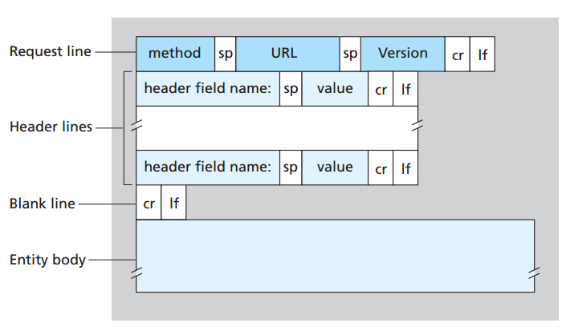
HTTP request message: general format

Slide 35
Uploading form input
POST method:
web page often includes form input
input is uploaded to server in entity body
URL method:
uses GET method
input is uploaded in URL field of request line:
www.somesite.com/animalsearch?monkeys&banana

Slide 36
Method types
HTTP/1.0:
GET
POST
HEAD
asks server to leave requested object out of response
HTTP/1.1:
GET, POST, HEAD
PUT
uploads file in entity body to path specified in URL field
DELETE
deletes file specified in the URL field

Slide 37
HTTP response message
status line
(protocol
status code
status phrase)
HTTP/1.1 200 OK\r\n
Date: Sun, 26 Sep 2010 20:09:20 GMT\r\n
Server: Apache/2.0.52 (CentOS)\r\n
Last-Modified: Tue, 30 Oct 2007 17:00:02 GMT\r\n
ETag: "17dc6-a5c-bf716880"\r\n
Accept-Ranges: bytes\r\n
Content-Length: 2652\r\n
Keep-Alive: timeout=10, max=100\r\n
Connection: Keep-Alive\r\n
Content-Type: text/html; charset=ISO-8859-1\r\n
\r\n
data data data data data ...
header
lines
data, e.g.,
requested
HTML file

Slide 38
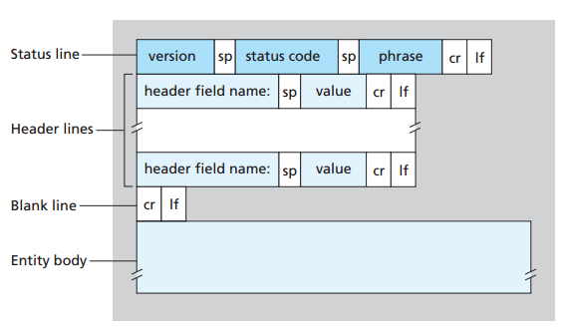
HTTP response message: general format

Slide 39
HTTP response status codes
Status code appears in 1st line in server-to-client response message.
Some sample codes:
200 OK
request succeeded, requested object later in this msg
301 Moved Permanently
requested object moved, new location specified later in this msg (Location:)
400 Bad Request
request msg not understood by server
404 Not Found
requested document not found on this server
505 HTTP Version Not Supported

Slide 40
Trying out HTTP (client side) for yourself
1. Telnet to your favorite Web server:
telnet cis.poly.edu 80
opens TCP connection to port 80
(default HTTP server port) at cis.poly.edu.
anything typed in sent
to port 80 at cis.poly.edu
2. type in a GET HTTP request:
GET /~ross/ HTTP/1.1
Host: cis.poly.edu
by typing this in (hit carriage
return twice), you send
this minimal (but complete)
GET request to HTTP server
3. look at response message sent by HTTP server!
(or use Wireshark to look at captured HTTP request/response)

Slide 41
User-server state: Cookies
Cookies allow sites to keep
track of users.
Four components of Cookie technology:
1) cookie header line of HTTP response message
2) cookie header line in next HTTP request message
3) cookie file kept on user’s host, managed by user’s browser
4) back-end database at Web site
Example:
Susan always access Internet from PC
visits specific e-commerce site for first time
when initial HTTP requests arrives at site, site creates:
unique ID
entry in back-end database for ID

Slide 42
Cookies: keeping “state” (cont.)
client
server
ebay 8734
usual http request msg
Amazon server
creates ID
1678 for user
cookie file
usual http response
set-cookie: 1678
backend
database
create
entry
ebay 8734
amazon 1678
usual http request msg
cookie: 1678
cookie-
specific
action
access
usual http response msg
one week later:
access
ebay 8734
amazon 1678
usual http request msg
cookie: 1678
cookie-
specific
action
usual http response msg

Slide 43
Cookies (continued)
Cookies are mainly used for:
Session management
Logins, shopping carts, game scores, or anything else the server should remember
Personalization
User preferences, themes, and other settings
Tracking
Recording and analyzing user behaviour
How to keep “state”:
Protocol endpoints: maintain state at sender/receiver over multiple transactions
Cookies: http messages carry state
Cookies and privacy:
Cookies permit sites to learn a lot about you
You may supply name and e-mail to sites

Slide 44

FTP: the file transfer protocol [RFC 959]
file transfer
FTP
user
interface
FTP
client
FTP
server
user
at host
remote file
system
local file
system
Transfer file to/from remote host
client/server model
client: side that initiates transfer (either to/from remote)
server: remote host
ftp: RFC 959
ftp server: port 21

Slide 45
FTP: separate control, data connections
TCP control connection,
server port 21
FTP
client
TCP data connection,
server port 20
FTP
server
FTP uses two parallel TCP connections to transfer a file: a control connection and a data connection
The control connection is used for sending control information between the two hosts—information such as user identification, password, commands to change remote directory, and commands to “put” and “get” files.
The data connection is used to actually send a file

Slide 46
FTP: separate control, data connections
TCP control connection,
server port 21
FTP
client
TCP data connection,
server port 20
FTP
server
FTP client contacts FTP server at port 21, using TCP
FTP client authorized over control connection
FTP client browses remote directory, sends commands over control connection
When server receives file transfer command, server opens 2nd TCP data connection (for file) to client at Port 20
After transferring one file, server closes data connection
Server opens another TCP data connection to transfer another file

Slide 47
FTP: separate control, data connections
TCP control connection,
server port 21
FTP
client
TCP data connection,
server port 20
FTP
server
FTP control connection: “out of band”
HTTP control connection: “in band” (sends request and response header lines into the same TCP connection that carries the transferred file itself)
FTP server maintains “state”: current directory, earlier authentication

Slide 48
FTP commands, responses
Some of the more common commands are given below:
USER username
PASS password
LIST returns list of file in current directory
RETR filename retrieves (gets) file
STOR filename stores (puts) file onto remote host

Slide 49
FTP commands, responses
Some typical replies, along with their possible messages, are as follows:
331 Username OK, password required
125 data connection already open; transfer starting
425 Can’t open data connection
452 Error writing file

Slide 50
Electronic mail
outgoing
message queue
user mailbox
Three major components:
user agents
mail servers
simple mail transfer protocol: SMTP
User Agent
a.k.a. “mail reader”
allows users to read, reply to, forward, save, and compose messages
e.g., Outlook, Thunderbird, iPhone mail client
outgoing, incoming messages stored on server
user
agent
mail
server
user
agent
SMTP
mail
server
user
agent
SMTP
SMTP
user
agent
mail
server
user
agent
user
agent

Slide 51
Electronic mail: mail servers
Mail servers:
mailbox contains incoming messages for user
message queue of outgoing (to be sent) mail messages
SMTP protocol between mail servers to send email messages
client: sending mail server
“server”: receiving mail server
user
agent
mail
server
user
agent
SMTP
mail
server
user
agent
SMTP
SMTP
user
agent
mail
server
user
agent
user
agent

Slide 52
Electronic Mail: SMTP [RFC 2821]
Uses TCP to reliably transfer email message from client to server, port 25
Direct transfer: sending server to receiving server
SMTP has two sides:
a client side, which executes on the sender’s mail server
a server side, which executes on the recipient’s mail server
Both the client and server sides of SMTP run on every mail server.

Slide 53

Scenario: Alice sends message to Bob
Alice uses UA to compose message “to” bob@someschool.edu
Alice’s UA sends message to her mail server; message placed in message queue
Client side of SMTP opens TCP connection with Bob’s mail server
4) SMTP client sends Alice’s message over the TCP connection
5) Bob’s mail server places the message in Bob’s mailbox
6) Bob invokes his user agent to read message
user
agent
mail
server
user
agent
1
mail
server
2
3
6
4
Alice’s mail server
5
Bob’s mail server

Slide 54
Sample SMTP interaction
S: 220 hamburger.edu
C: HELO crepes.fr
S: 250 Hello crepes.fr, pleased to meet you
C: MAIL FROM: <alice@crepes.fr>
S: 250 alice@crepes.fr... Sender ok
C: RCPT TO: <bob@hamburger.edu>
S: 250 bob@hamburger.edu ... Recipient ok
C: DATA
S: 354 Enter mail, end with "." on a line by itself
C: Do you like ketchup?
C: How about pickles?
C: .
S: 250 Message accepted for delivery
C: QUIT
S: 221 hamburger.edu closing connection

Slide 55
SMTP: final words
SMTP uses persistent connections
SMTP requires message (header & body) to be in 7-bit ASCII
Comparison with HTTP:
HTTP: pull
SMTP: push
both have ASCII command/response interaction, status codes
HTTP: each object encapsulated in its own response msg
SMTP: multiple objects sent in multipart msg

Slide 56
Pull/Push
HTTP is mainly a pull protocol—someone loads information on a Web server and users use HTTP to pull the information from the server at their convenience.
In particular, the TCP connection is initiated by the machine that wants to receive the file.
On the other hand, SMTP is primarily a push protocol—the sending mail server pushes the file to the receiving mail server.
In particular, the TCP connection is initiated by the machine that wants to send the file.

Slide 57
Mail access protocols
user
agent
mail access
protocol
user
agent
SMTP
SMTP
(e.g., POP,
IMAP)
sender’s mail
server
receiver’s mail
server
SMTP: delivery/storage to receiver’s server
Mail access protocol: retrieval from server
POP: Post Office Protocol [RFC 1939]: authorization, download
IMAP: Internet Mail Access Protocol [RFC 1730]: more features, including manipulation of stored msgs on server
HTTP: Gmail, Hotmail, Yahoo! Mail, etc.

Slide 58
POP3 protocol
S: +OK POP3 server ready
C: user bob
S: +OK
C: pass hungry
S: +OK user successfully logged on
authorization phase
client commands:
user: declare username
pass: password
server responses
+OK
-ERR
transaction phase, client:
list: list message numbers
retr: retrieve message by number
dele: delete
quit
C: list
S: 1 498
S: 2 912
S: .
C: retr 1
S: <message 1 contents>
S: .
C: dele 1
C: retr 2
S: <message 1 contents>
S: .
C: dele 2
C: quit
S: +OK POP3 server signing off

Slide 59
POP3 (more) and IMAP
more about POP3
POP3 begins when the user agent (the client) opens a TCP connection to the mail server (the server) on port 110
Previous example uses POP3 “download and delete” mode
Bob cannot re-read e-mail if he changes client
POP3 “download-and-keep”: copies of messages on different clients
POP3 is stateless across sessions
IMAP
keeps all messages in one place: at server
allows user to organize messages in folders
keeps user state across sessions:
names of folders and mappings between message IDs and folder name

Slide 60
DNS: Domain Name System
People: many identifiers:
NID, name, passport #
Internet hosts, routers:
IP address (32 bit) - used for addressing datagrams
“hostname”, e.g., www.yahoo.com - used by humans
Q: how to map between IP address and hostname, and vice versa ?
Domain Name System:
Distributed database implemented in hierarchy of many name servers
Application-layer protocol: hosts, name servers communicate to resolve hostnames (address/name translation)
DNS protocol runs over UDP and uses port 53

Slide 61
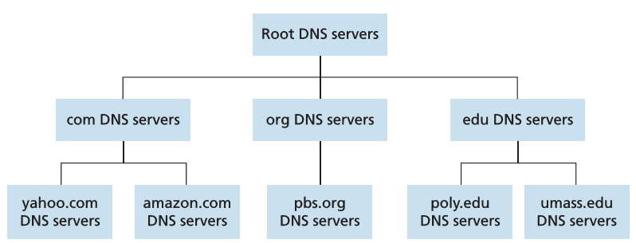
DNS: a Distributed, Hierarchical database
Root DNS Servers
Top-Level Domain (TLD) DNS servers
authoritative DNS servers
Client wants IP for www.amazon.com; 1st approx:
Client queries root server to find com DNS server
Client queries .com DNS server to get amazon.com DNS server
Client queries amazon.com DNS server to get IP address for www.amazon.com

Slide 62
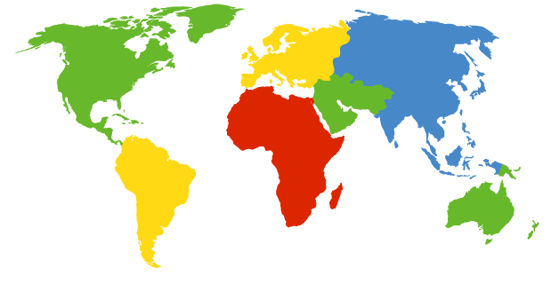
DNS: root name servers
Contacted by local name server that can not resolve name
Root name server:
contacts authoritative name server if name mapping not known
gets mapping
returns mapping to local name server
c. Cogent, Herndon, VA (5 other sites)
d. U Maryland College Park, MD
h. ARL Aberdeen, MD
j. Verisign, Dulles VA (69 other sites )
k. RIPE London (17 other sites)
i. Netnod, Stockholm (37 other sites)
e. NASA Mt View, CA
f. Internet Software C.
Palo Alto, CA (and 48 other sites)
m. WIDE Tokyo
(5 other sites)
13 root name “servers” worldwide
All together, there are 997 root servers as of 11 July 2019
a. Verisign, Los Angeles CA
(5 other sites)
b. USC-ISI Marina del Rey, CA
l. ICANN Los Angeles, CA
(41 other sites)
g. US DoD Columbus, OH (5 other sites)

Slide 63
TLD and Authoritative servers
Top-Level Domain (TLD) DNS Servers:
Responsible for com, org, net, edu, aero, jobs, museums, and all top-level country domains, e.g.: bd, uk, fr, ca, jp
Network Solutions maintains servers for .com TLD
Authoritative DNS servers:
Organization’s own DNS server(s), providing authoritative hostname to IP mappings for organization’s named hosts
Can be maintained by organization or service provider

Slide 64
Local DNS name server
Does not strictly belong to hierarchy
Each ISP (residential ISP, company, university) has one
also called “default name server”
When host makes DNS query, query is sent to its local DNS server
has local cache of recent name-to-address translation pairs (but may be out of date!)
acts as proxy, forwards query into hierarchy

Slide 65
DNS name resolution example
root DNS server
2
Host at cis.poly.edu wants IP address for gaia.cs.umass.edu
3
TLD DNS server
4
5
Iterated Query:
Contacted server replies with name of server to contact
local DNS server
dns.poly.edu
7
6
1
8
authoritative DNS server
dns.cs.umass.edu
requesting host
cis.poly.edu
gaia.cs.umass.edu

Slide 66
DNS name resolution example
root DNS server
2
3
Recursive Query:
puts burden of name resolution on contacted name server
7
6
TLD DNS
server
local DNS server
dns.poly.edu
5
4
1
8
authoritative DNS server
dns.cs.umass.edu
requesting host
cis.poly.edu
gaia.cs.umass.edu

